Slide 1
Python programing
Mr. Tissana Tanaklang

Slide 2

Agenda
Introduction to Python
Basic Python Programming
Functions
Modules and Packages
File
Object Oriented Programming
Exceptions
Database
GUI
Git Version control

Slide 3
Introduction to Python

Slide 4
Title
Subtitle
Subtitle
Subtitle
Add text, images, art, and videos.
Add transitions, animations, and motion.
Save to OneDrive, to get to your presentations from your computer, tablet, or phone.
Open the Design Ideas pane for instant slide makeovers.
When we have design ideas, we’ll show them to you right there.
This PowerPoint theme uses its own unique set of colors, fonts, and effects to create the overall look and feel of these slides.
PowerPoint has tons of themes to give your presentation just the right personality.

Slide 5
Basic Python Programming

Slide 6
Identifiers
A Python identifier is a name used to identify a variable, function, class, module or other object.
An identifier starts with a letter A to Z or a to z or an underscore (_) followed by zero or more letters, underscores and digits (0 to 9).
Python does not allow punctuation characters such as @, $, and % within identifiers.
Python is a case sensitive programming language.

Slide 7
Reserved Words
False | def | if | raise
None | del | import | return
True | elif | in | try
and | else | is | while
as | except | lambda | with
assert | finally | nonlocal | yield
break | for | not
class | form | or
continue | global | pass

Slide 8
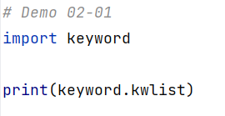
Reserved Words

Slide 9
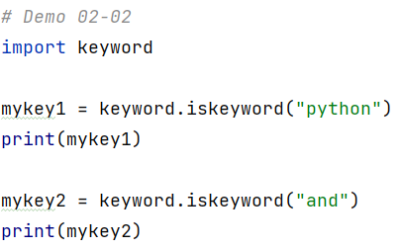

Reserved Words

Slide 10
Lines and Indentation
Python provides no braces to indicate blocks of code for class and function definitions or flow control.
Blocks of code are denoted by line indentation.
Correct | Incorrect
if True: print "True" else: print "False" | if True: print "Answer" print "True" else: print "Answer" print "False"

Slide 11
Data Type
Data Type | Example
Text | str
Numeric | int, float, complex
Sequence | list, tuple, range
Mapping | dict
Set | set, frozenset
Boolean | bool
Binary | bytes, bytearray, memoryview
None | NoneType

Slide 12
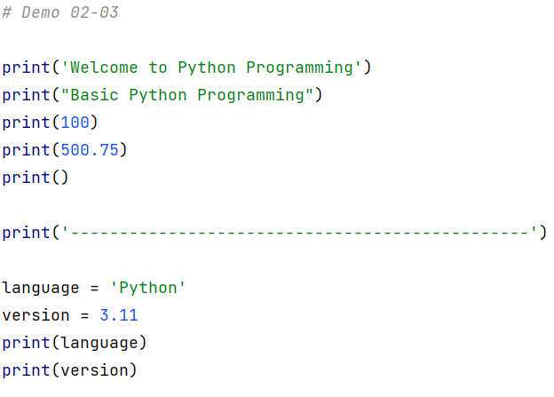
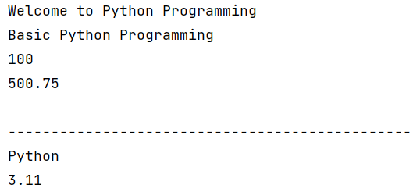
Print Function

Slide 13
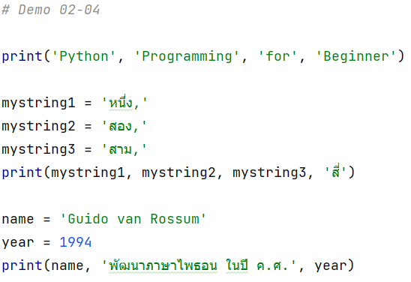

Print Function

Slide 14
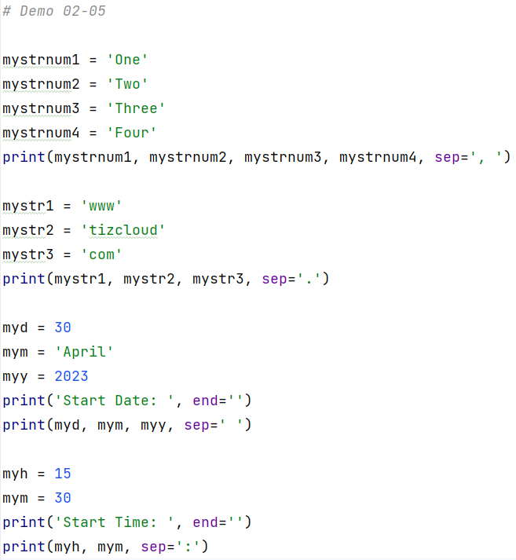
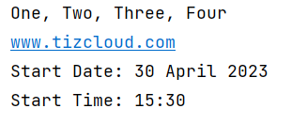
Print Function

Slide 15
String
Strings in python are surrounded by either single quotation marks, or double quotation marks.
'Python' is the same as "Python".

Slide 16
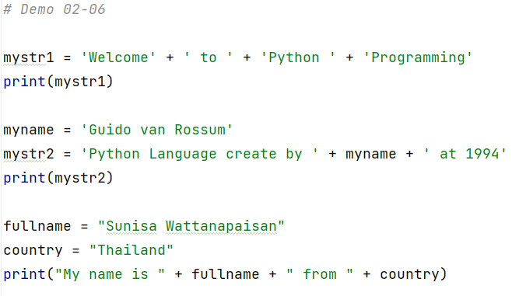

String Concatenation

Slide 17
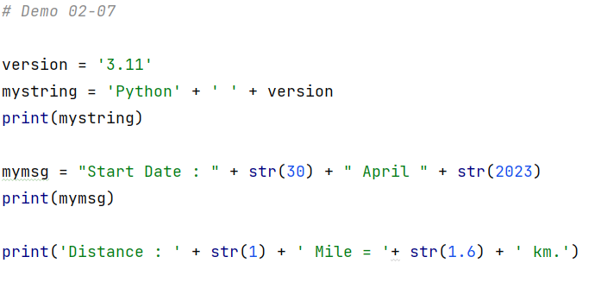
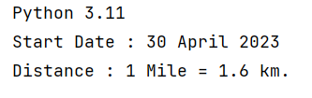
String Concatenation

Slide 18
Escaping Sequences
Escape Sequence | Meaning
\’ | Single quote
\” | Double quote
\\ | Backslash
\n | Newline
\r | Carriage Return
\t | Horizontal Tab
\b | Backspace
\f | Formfeed
\v | Vertical Tab
\0 | Null Character
Notes:
\ (Backslash) ไม่สนใจ (Ignored) หรือ ต้องการพิมพ์ค าสั่งเดียวกันยาวๆ
\' (Single quote) พิมพ์เครื่องหมาย ' ออกจอภาพ
\" (Double quote) พิมพ์เครื่องหมาย " ออกจอภาพ
\\ (Double backslash) พิมพ์เครื่องหมาย \ ออกจอภาพ
\n (Newline: LF) ขึ้นบรรทัดใหม่ 1 บรรทัด
\r (Carriage return: CR) เลื่อนเคอเซอร์ไปทางซ้ายมือสุดของบรรทัด
\t (Tab) ตั้งแท็บในแนวนอน
\b (Backspace) เลื่อนเคอเซอร์ไปลบตัวอักษรทางซ้ายมือหนึ่งตัวอักษร
\f (Formfeed: FF) ขึ้นหน้าใหม
\v (Vertical tab: VT) ตั้งแท็บในแนวตั้ง

Slide 19
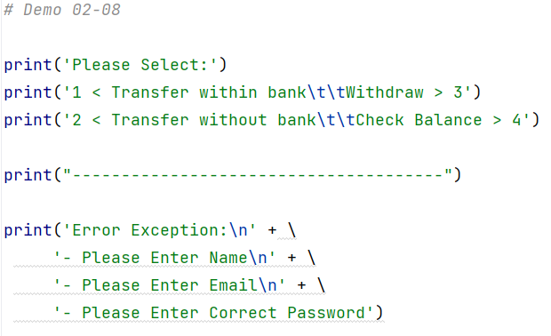
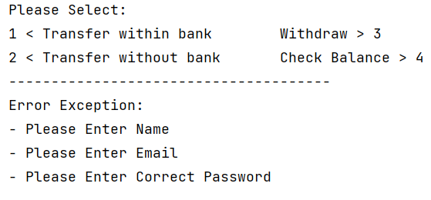
Escaping Sequences

Slide 20
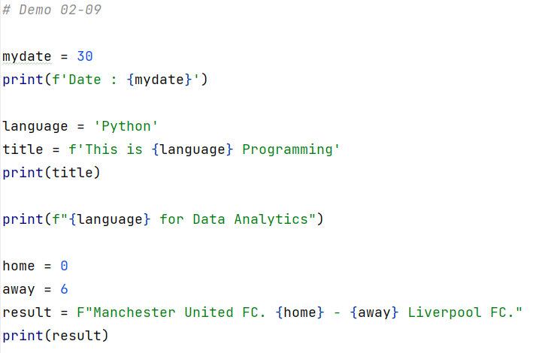
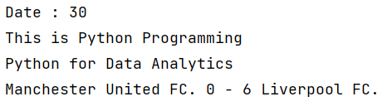
Insert information to String

Slide 21
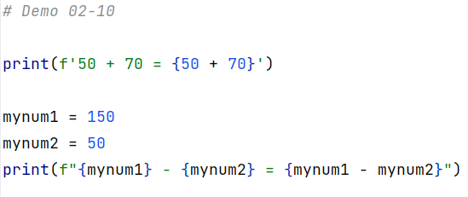

Insert information to String

Slide 22
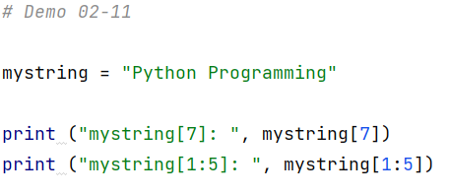

String

Slide 23
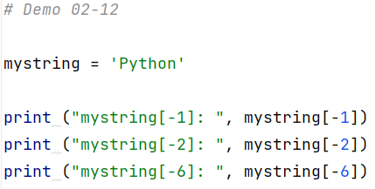


String

Slide 24
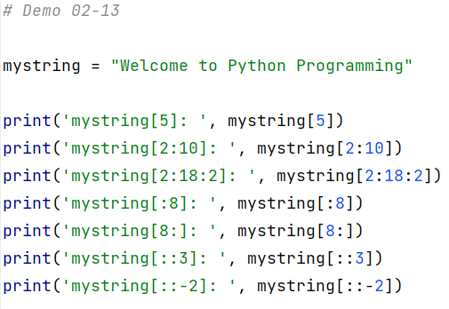
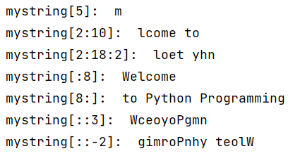
String

Slide 25
List
Lists are used to store multiple items in a single variable.
Lists are one of 4 built-in data types in Python used to store collections of data, the other 3 are Tuple, Set, and Dictionary, all with different qualities and usage.

Slide 26
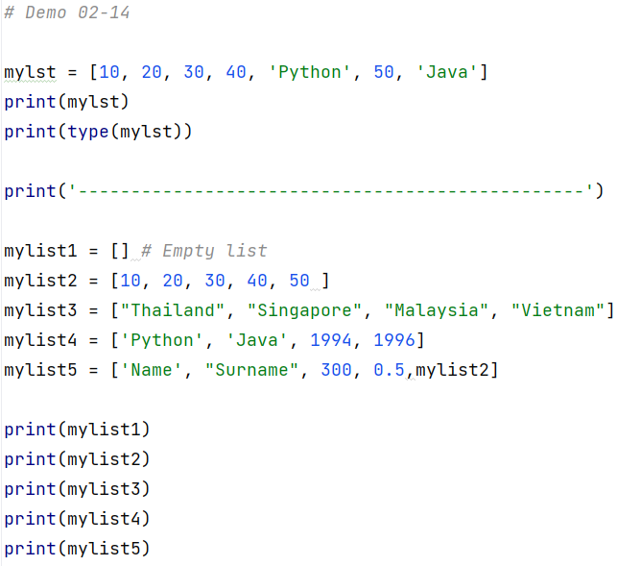
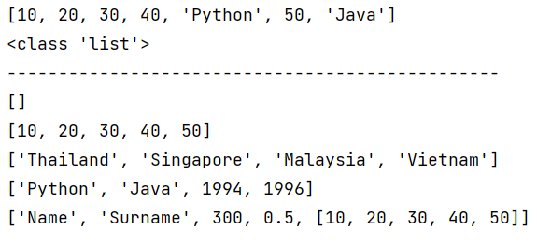
List

Slide 27
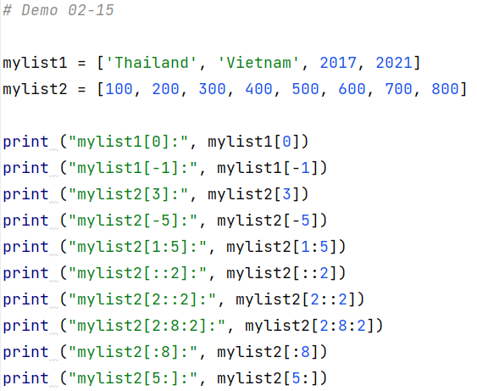
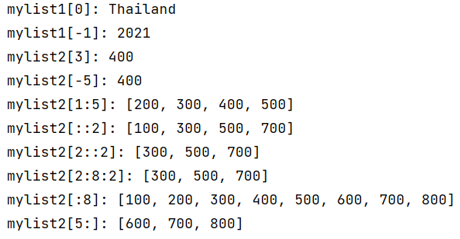
List

Slide 28
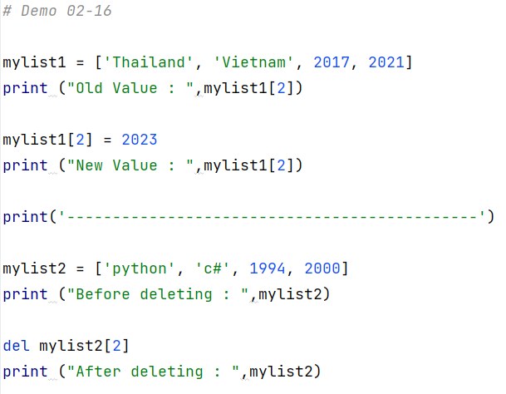
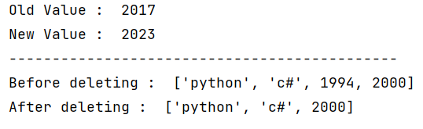
List

Slide 29
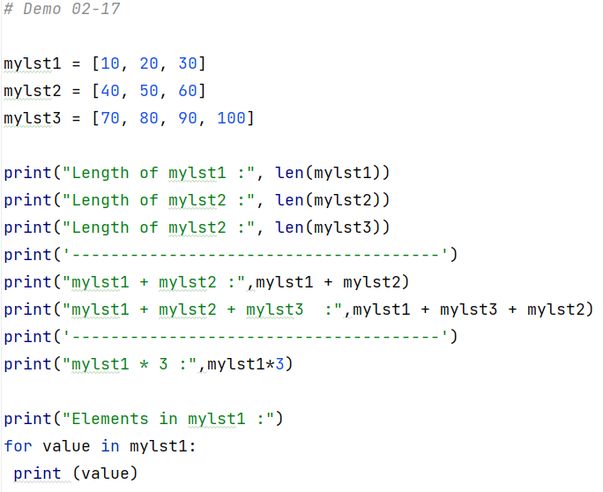
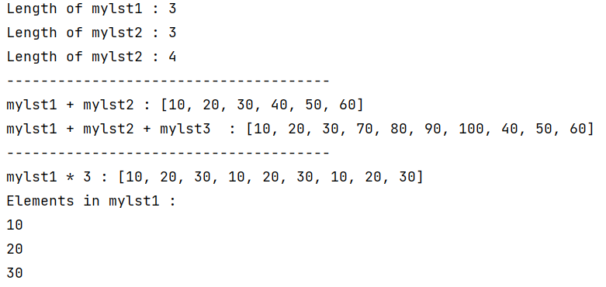
List

Slide 30
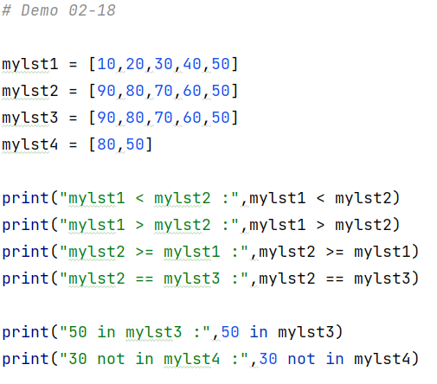
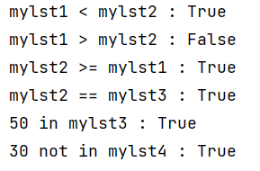
List
Notes:
การเปรียบเทียบในลิสต์จะเป็นการเปรียบเทียบในลักษณะค่าต่อค่า หรือสมาชิกต่อสมาชิก ทีละ ตัวไปเรื่อยๆ ในกรณีแรก
mylst1 < mylst2 โปรแกรมจะเริ่มตรวจสอบคู่ของ mylst1 และ mylst2 คู่แรกก่อน
ในที่นี้คือ 10 (mylst1[0]) กับ 90 (mylst2[0]) ผลที่ได้คือ 10 < 90 จริง ดังนั้นผลลัพธ์ที่ได้จะเป็นจริง (True)

Slide 31
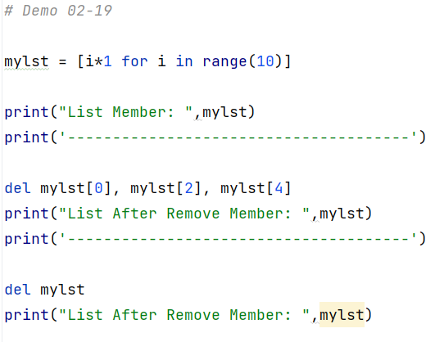
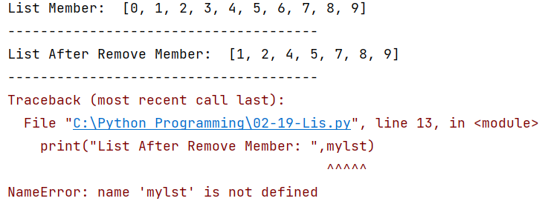
List

Slide 32
Tuples
Tuples are used to store multiple items in a single variable.
Tuple is one of 4 built-in data types in Python used to store collections of data, the other 3 are List, Set, and Dictionary, all with different qualities and usage.
A tuple is a collection which is ordered and unchangeable.
Tuples are written with round brackets.
Notes:
ทัพเพิลมีลักษณะโครงสร้างคล้ายกับลิสต์ คือ สามารถเก็บข้อมูลได้ในปริมาณมาก และสามารถ เก็บข้อมูลต่างประเภทกันได้ภายในตัวแปรเดียวกัน ข้อแตกต่างระหว่างลิสต์กับทัพเพิลคือ ทัพเพิลจะใช้ ส าหรับเก็บข้อมูลที่มีค่าคงที่ และไม่มีการเปลี่ยนแปลง

Slide 33
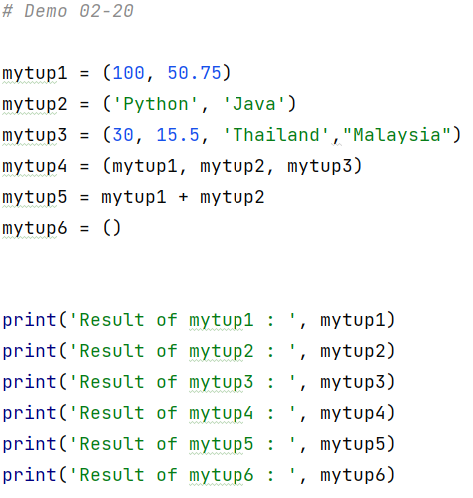
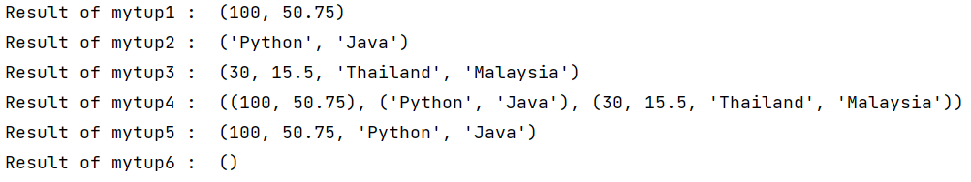
Tuples

Slide 34
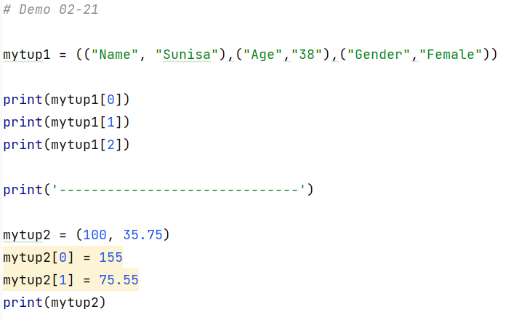
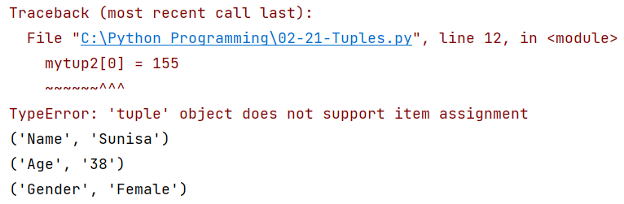
Tuples

Slide 35
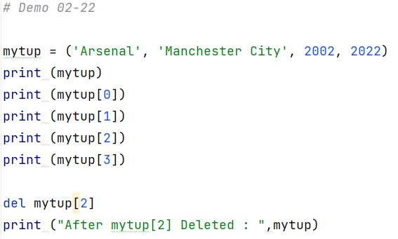
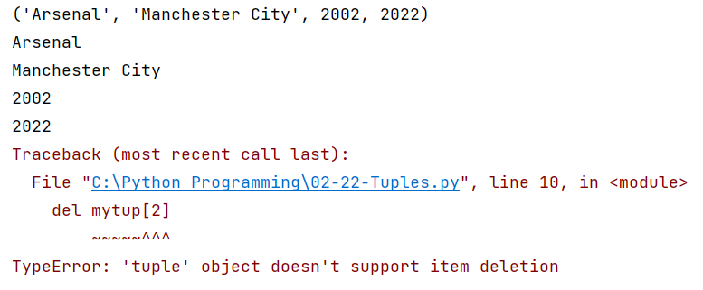
Tuples

Slide 36
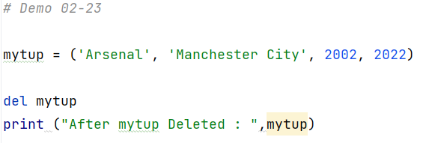
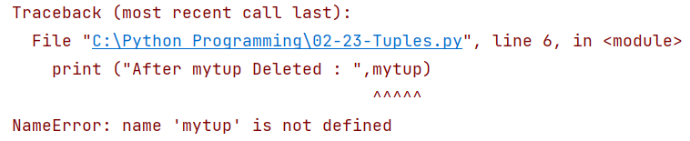
Tuples

Slide 37
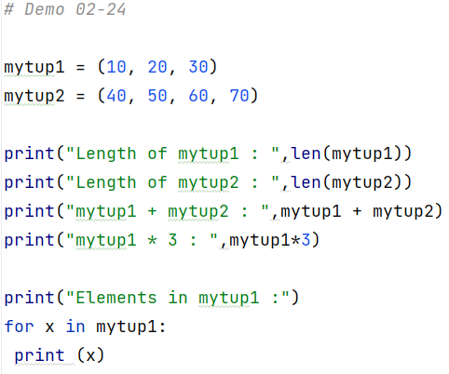
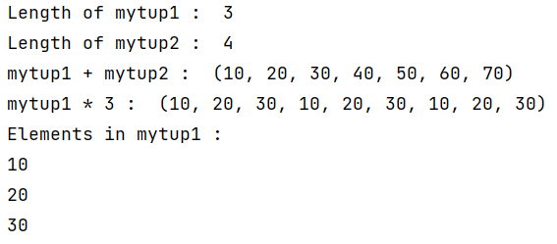
Tuples

Slide 38
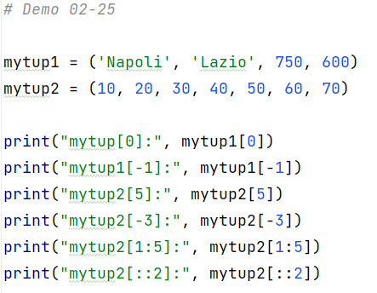
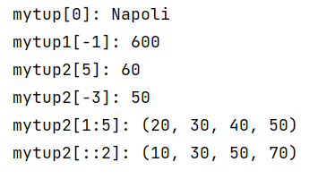
Tuples

Slide 39
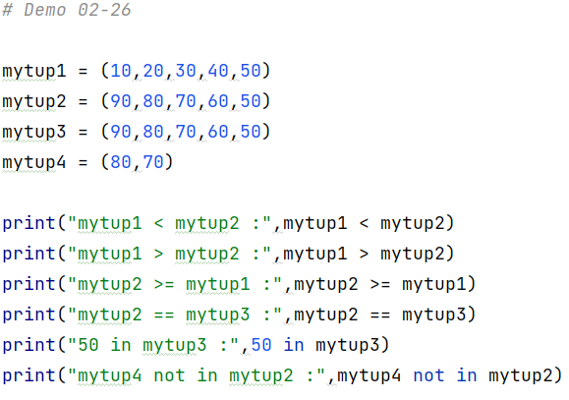
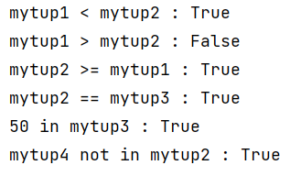
Tuples

Slide 40
Dictionary
Dictionaries are used to store data values in key:value pairs.
A dictionary is a collection which is ordered*, changeable and do not allow duplicates.
As of Python version 3.7, dictionaries are ordered. In Python 3.6 and earlier, dictionaries are unordered.

Slide 41
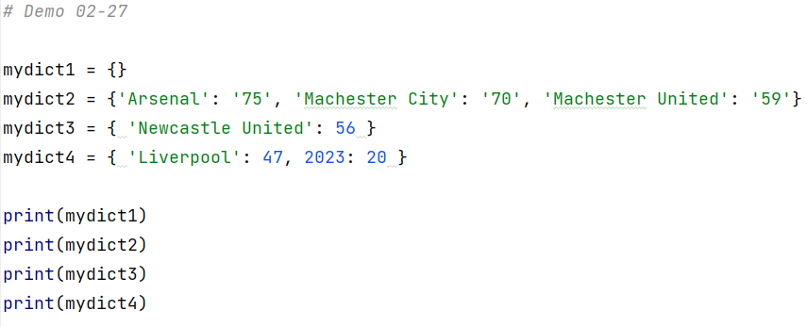
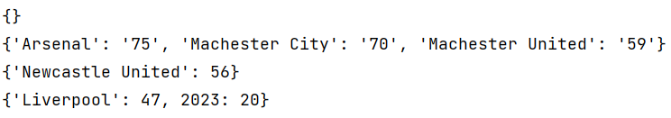
Dictionary

Slide 42
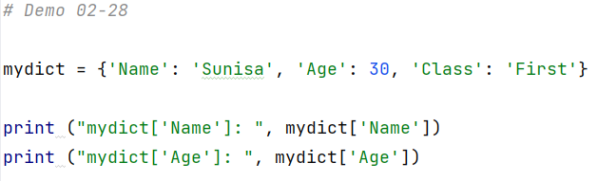

Dictionary

Slide 43
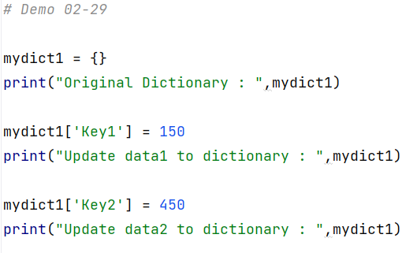

Dictionary

Slide 44
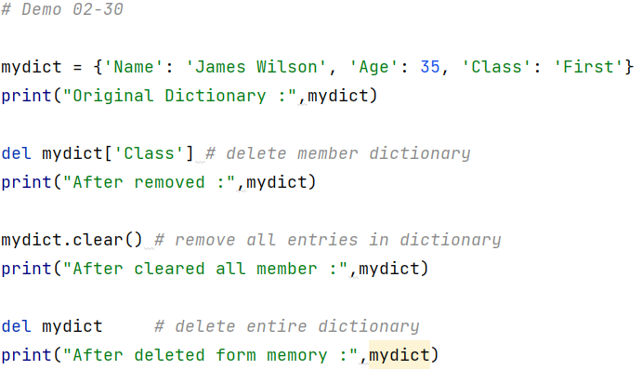

Dictionary

Slide 45


Dictionary

Slide 46
Sets
Sets are used to store multiple items in a single variable.
Set is one of 4 built-in data types in Python used to store collections of data, the other 3 are List, Tuple, and Dictionary, all with different qualities and usage.
A set is a collection which is unordered, unchangeable*, and unindexed.
Set items are unchangeable, but you can remove items and add new items.

Slide 47


Sets

Slide 48



Sets - Union

Slide 49



Sets - Intersection

Slide 50



Sets - Difference

Slide 51



Sets - Symmetric Difference

Slide 52
Arithmetic Operators
Operator | Name | Example
+ | Addition | x + y
- | Subtraction | x - y
* | Multiplication | x * y
/ | Division | x / y
% | Modulus | x % y
** | Exponentiation | x ** y
// | Floor division | x // y

Slide 53
Assignment Operators
Operator | Name | Example
= | x = 5 | x = 5
+= | x += 3 | x = x + 3
-= | x -= 3 | x = x - 3
*= | x *= 3 | x = x * 3
/= | x /= 3 | x = x / 3
%= | x %= 3 | x = x % 3
//= | x //= 3 | x = x // 3

Slide 54
Assignment Operators (Con.t)
Operator | Name | Example
**= | x **= 3 | x = x ** 3
&= | x &= 3 | x = x & 3
|= | x |= 3 | x = x | 3
^= | x ^= 3 | x = x ^ 3
>>= | x >>= 3 | x = x >> 3
<<= | x <<= 3 | x = x << 3

Slide 55
Comparison Operators
Operator | Name | Example
== | Equal | x == y
!= | Not equal | x != y
> | Greater than | x > y
< | Less than | x < y
>= | Greater than or equal to | x >= y
<= | Less than or equal to | x <= y

Slide 56
Logical Operators
Operator | Name | Example
and | Returns True if both statements are true | x < 5 and x < 10
or | Returns True if one of the statements is true | x < 5 or x < 4
not | Reverse the result, returns False if the result is true | not(x < 5 and x < 10)

Slide 57
Identity Operators
Operator | Name | Example
is | Returns True if both variables are the same object | x is y
is not | Returns True if both variables are not the same object | x is not y

Slide 58
Membership Operators
Operator | Name | Example
in | Returns True if a sequence with the specified value is present in the object | x in y
not in | Returns True if a sequence with the specified value is not present in the object | x not in y

Slide 59
Bitwise Operators
Operator | Name | Description | Example
& | AND | Sets each bit to 1 if both bits are 1 | x & y
| | OR | Sets each bit to 1 if one of two bits is 1 | x | y
^ | XOR | Sets each bit to 1 if only one of two bits is 1 | x ^ y
~ | NOT | Inverts all the bits | ~x
<< | Zero fill left shift | Shift left by pushing zeros in from the right and let the leftmost bits fall off | x << 2
>> | Signed right shift | Shift right by pushing copies of the leftmost bit in from the left, and let the rightmost bits fall off | x >> 2

Slide 60


if statements

Slide 61



if-else statements

Slide 62


if-elif-else statements

Slide 63


Nested if

Slide 64




Thank you

